Slide 1
AWS Systems Manager
AWS Certified Solutions Architect– Professional (SAP-C01)
Study notes - Sep’2019

Slide 2
What is SSM
View and control your infrastructure on AWS. Using the SSM console, you can view operational data from multiple AWS services and automate operational tasks across your AWS resources. Systems Manager helps you maintain security and compliance by scanning your managed instances and reporting on (or taking corrective action on) any policy violations it detects
Example Capabilities:
Group AWS resources together by any purpose or activity you choose, such as application, environment, region, project, campaign, business unit, or software lifecycle.
Centrally define the configuration options and policies for your managed instances.
Centrally view, investigate, and resolve operational work items related to AWS resources.
Automate or schedule a variety of maintenance and deployment tasks.
Use and create runbook-style SSM documents that define the actions to perform on your managed instances.
Run a command, with rate and error controls, that targets an entire fleet of managed instances.
Securely connect to a managed instance, without having to open an inbound port or manage SSH keys.
Separate your secrets and configuration data from your code by using parameters, with or without encryption, and then reference those parameters from a number of other AWS services.
Perform automated inventory by collecting metadata about your Amazon EC2 and on-premises managed instances. Metadata can include information about applications, network configurations, and more.
View consolidated inventory data from multiple AWS Regions and accounts that you manage.
Quickly see which resources in your account are out of compliance and take corrective action from a centralized dashboard.
View active summaries of metrics and alarms for your AWS resources.

Slide 3
SSM capabilities can be grouped into 4 groups
SSM
Operations Mgmt
CloudWatch Dashboards
OpsCenter
AWS Resource Groups
Trusted Advisor & Personal Health Dashboard (PHD)
Actions & Change
Systems Manager Automation
Maintenance Windows
Instances & Nodes
Systems Manager Configuration Compliance
Inventory Manager
Managed Instance
Session Manager
Run Command
State Manager
Patch Manager
Distributor
Shared Resources
Systems Manager document
Parameter Store

Slide 4
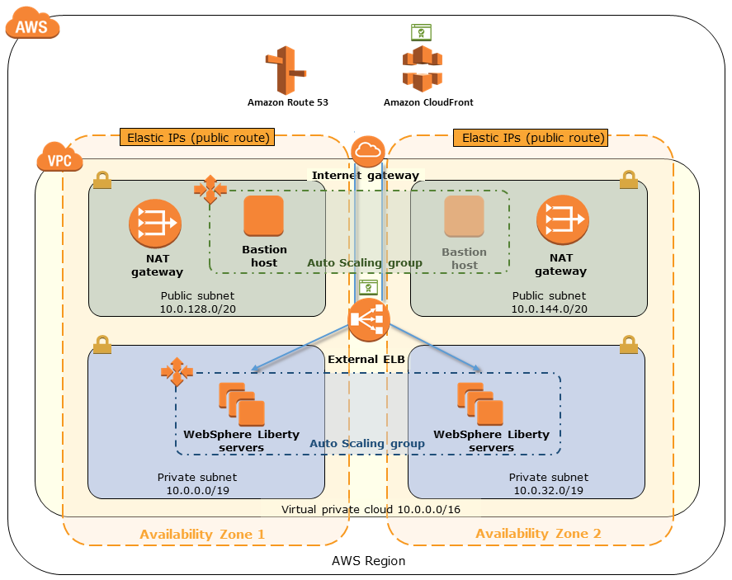
Sample EC2 stack
https://aws.amazon.com/quickstart/architecture/ibm-websphere-liberty/
https://aws-quickstart.s3.amazonaws.com/quickstart-ibm-websphere-liberty/doc/ibm-websphere-liberty-on-the-aws-cloud.pdf
A virtual private cloud (VPC) configured across two Availability Zones.
In each Availability Zone, this Quick Start provisions one public subnet and one private
subnet. This creates a logically isolated networking environment that you can connect to
your on-premises data centers or use as a standalone environment.*
An internet gateway to provide internet access to each subnet.*
Managed NAT gateways deployed into the public subnets and configured with an
Elastic IP address for outbound internet connectivity. These instances provide
internet access for all EC2 instances launched within the private network.*
A Linux bastion host in the public subnet to allow inbound Secure Shell (SSH) access to
the WebSphere Liberty instances in the private subnets.*
In the private subnets, WebSphere Liberty server instances across both Availability Zones, to ensure high availability.
Auto Scaling enabled for the WebSphere Liberty cluster, to automatically add or remove servers based on their use, providing additional servers during peak hours and lowering costs by removing servers during off hours. This functionality is tightly integrated with the Application Load Balancer and automatically adds and removes instances from the load balancer. The default installation sets up CPU-based thresholds for scaling the instance capacity up or down. You can modify these thresholds during launch and after deployment.
The Elastic Load Balancing service, which provides HTTP and HTTPS load balancing across the WebSphere Liberty instances. This Quick Start uses an Application Load Balancer, which is configured to use HTTP.
An IAM role with fine-grained permissions for access to AWS services necessary for the deployment process.
Appropriate security groups for each instance or function to restrict access to only necessary protocols and ports. For example, access to HTTP(S)­ server ports on Amazon EC2 web servers is limited to the Application Load Balancer.
Amazon CloudFront as an optional content delivery network. This service enables caching of static content at the edge locations and results in lower latency in delivering content to end users. The edge locations include many Points of Presence (PoPs) across the globe to ensure low latency.
In case of SSL/TLS implementation, AWS Certificate Manager (ACM) to provision certificates for the Application Load Balancer and CloudFront. If you’re using the default CloudFront certificate, ACM is not required.

Slide 5

Systems Manager setup
Create Non-Admin IAM Users and Groups for Systems Manager
Users in the administrators group for an account have access to all AWS services and resources in that account. It is recommended to create users with permissions that are limited to AWS Systems Manager.
You manage access in AWS by creating policies and attaching them to IAM identities (users, groups of users, or roles) or AWS resources. A policy is an object in AWS that, when associated with an identity or resource, defines their permissions.
Login as admin user
Create Policy
SSMTagEditorAndResourceGroupAccess
Create User Group for SSM users (SSMUserGroup)
Attach appropriate policy to the User group
Create user (ssmuser) & assign permissions
(SSMUserGroup)
create a user group for each policy and assign users to a group rather than attaching individual policies to each user.
To provide users in this group with full access to the Systems Manager console, select the box next to AmazonSSMFullAccess.
If you want to provide users with permission to use Resource Groups and the Tag Editor, choose the SSMTagEditorAndResourceGroupAccess

Slide 6
Systems Manager setup
Create & Attach an IAM Instance Profile for Systems Manager
Best practise: To provide permissions for communication between instances and the Systems Manager API, we recommend creating custom policies that take into account your system needs and security requirements.
AWS Systems Manager doesn't have permission to perform actions on your instances
You need to create an Instance profile
An Instance profile is a container that passes IAM role information to an EC2 instance at launch
Create an Instance profile by attaching 1 or more IAM policies to a Role
After you create the instance profile, you attach it to the instances that you want to use with SSM
Step 1: Create an IAM Instance Profile for Systems Manager
Attach permissions:
AmazonSSMManagedInstanceCore
Custom policy for S3 bucket (optional)
AmazonSSMDirectoryServiceAccess
CloudWatchAgentServerPolicy
Create Role
“SSMInstanceProfile”
Select type of trusted entity - EC2
Choose this role when you create new instances that you want to manage by using Systems Manager.
Step 2: Attach an IAM Instance Profile to an Amazon EC2 Instance
Prerequisite: SSM agent & TLS certificate must be installed in the EC2 instance (already present in Amazon AMIs)
In console, Launch Instance → Choose an AMI → Configure Instance details → Select the IAM role “SSMInstanceProfile”

Slide 7
Operations Management -
AWS Systems Manager OpsCenter
OpsCenter provides a central location where operations engineers can view, investigate, and resolve operational work items (OpsItems). OpsCenter is designed to reduce mean time to resolution
OpsCenter can create CW rules for the foll. common operational events:
EC2 Instance State-change - Stopped or Terminated
EBS Snapshot Notification - Copy/Create/Share Failed
AutoScaling EC2 Instance Launch/Term Unsuccessful
EC2 SSM Maintenance Window Execution Failed/Timed Out
AWS Health - RDS Maintenance Scheduled
AWS Health - RDS Issue Notification (example: RDSConnectivity issue)
AWS Health - EC2 Maintenance Scheduled
AWS Health - EC2 Issue Notification (example:Instance Auto Recovery Failure)
AWS Health - EBS Issue Notification (example:Degraded EBS volume performance)
Features:
Automated and manual OpsItem creation - automatically create OpsItems for any AWS service that publishes events to CloudWatch Events. Also can be manual
Detailed and searchable OpsItems & Summary reports
Easy remediation using runbooks
Change notification
IAM Access control

Slide 8
Actions and Change
AWS Systems Manager Automation
Build Automation workflows to configure and manage instances and AWS resources.
Create custom workflows or use pre-defined workflows maintained by AWS.
Receive notifications about Automation tasks and workflows by using CW Events.
Monitor Automation progress and execution details by using the EC2 or SSM console.
Automation Use Cases:
Perform common IT tasks. e.gs:
AWS-StopEC2InstanceWithApproval document
AWS-StopEC2Instance document
AWS-UpdateCloudFormationStackWithApproval document
Safely perform disruptive tasks in bulk. e.gs:
AWS-RestartEC2InstanceWithApproval document for multiple instances
Simplify complex tasks. e.gs:
AWS-UpdateLinuxAmi and AWS-UpdateWindowsAmi documents to create golden AMIs from a source AMI.
AWSSupport-ExecuteEC2Rescue document to recover impaired instances.
Enhance operations security
Use delegated administration. Create an IAM role with the permissions required to successfully stop and start EC2 instances. Customize the AWS-RestartEC2Instance document and embed the role in the document
Share best practices
An SSM automation document defines the Automation workflow (the actions that Systems Manager performs on your managed instances and AWS resources).
Automation Executions:
Running a Simple Automation Workflow
Running an Automation Workflow Step by Step
Running an Automation Workflow with Approvers
Running Automation Workflows That Use Targets and Rate Controls (Concurrency & Error threshold)
Running Automation based on Triggers
CloudWatch EVENTS
State Manager
Maintenance Windows
You can have a maximum of 25 concurrent Automations running at one time.

Slide 9
AWS Systems Manager Automation
Simplify AMI Patching Using Automation, Lambda, and Parameter Store
Using Automation with Jenkins deployed on EC2 via CLI
This example uses the model where an organization maintains and periodically patches their own, proprietary AMIs rather than building from Amazon EC2 AMIs.
Task 1: Create a Parameter in Systems Manager Parameter Store
Name: latestAmi. Value: a Windows AMI ID. For example: ami-188d6e0e.
Task 2: Create an IAM Role for AWS Lambda
Includes AWSLambdaExecute and AmazonSSMFullAccess managed policies. These policies give Lambda permission to update the value of the latestAmi parameter using a Lambda function and SSM
Task 3: Create an AWS Lambda Function
function automatically updates the value of the latestAmi parameter
Task 4: Create an Automation Document (‘UpdateMyLatestWindowsAmi’) and Patch the AMI
You can add Automation as a post-build step to pre-install application releases into AMIs. You can also use the Jenkins scheduling feature to call Automation and create your own OS patching cadence.
Task 5: Configure IAM roles for Automation.
SSM requires an instance profile role and a service role ARN to process Automation workflows
Task 6: Create an IAM user account for your Jenkins server.
The Automation workflow uses the IAM user account's Access key and Secret key to authenticate the Jenkins server during execution. For permissions, assign ‘AmazonSSMFullAccess’ policy
Task 7 : Configure Jenkins for Automation
In Jenkins EC2, configure AWS CLI with the AWS Access key and secret key created above
In Jenkins console, Choose project → Add build step → Execute shell command → run foll. Command:
aws --region region-id ssm start-automation-execution \
--document-name UpdateMyLatestWindowsAmi \
--parameters \
"sourceAMIid='{{ssm:latestAmi}}'"

Slide 10
AWS Systems Manager Maintenance Windows
Controlling Access to Maintenance Windows:
Task 1: Configure instance permissions
Provide the Maintenance Windows service with the IAM permissions needed to run maintenance window tasks on your instances by doing one of the following:
Create a custom service role for maintenance window tasks
Create a service-linked role for SSM
Task 2: Configure user permissions
Granting iam:PassRole permissions to the users in your account who assigns tasks to maintenance windows. Without this explicit permission, a user can't assign tasks to a maintenance window.
AWS Systems Manager Maintenance Windows let you define a schedule for when to perform potentially disruptive actions on your instances such as patching an operating system, updating drivers, or installing software or patches.
Each maintenance window has a:
Schedule (dates to run or not run, in I18N time zone)
a maximum duration
a set of registered targets (the instances or other AWS resources that are acted upon) and
a set of registered tasks.
Maintenance windows support running four types of tasks:
Systems Manager Run Command commands
Systems Manager Automation workflows
AWS Lambda functions
AWS Step Functions tasks
Should I Use a Service-Linked Role or a Custom Service Role to Run Maintenance Window Tasks?
Use Custom Service Role IF:
You want to send SNS notifications
You want More restrictive permissions (e.g. limited instances or restrict to certain SSM documents)
You want More permissive permissions (e.g. Use CloudFormation or Create EBS snapshot)
For All other use cases, use Service-linked Role
A service-linked role is a unique type of IAM role that is linked directly to Systems Manager. Service-linked roles are predefined by Systems Manager and include all the permissions that the service requires to call other AWS services on your behalf. Systems Manager uses the service-linked role named AWSServiceRoleForAmazonSSM
Currently, only two Systems Manager capabilities use the service-linked role: Inventory & Maintenance Windows

Slide 11
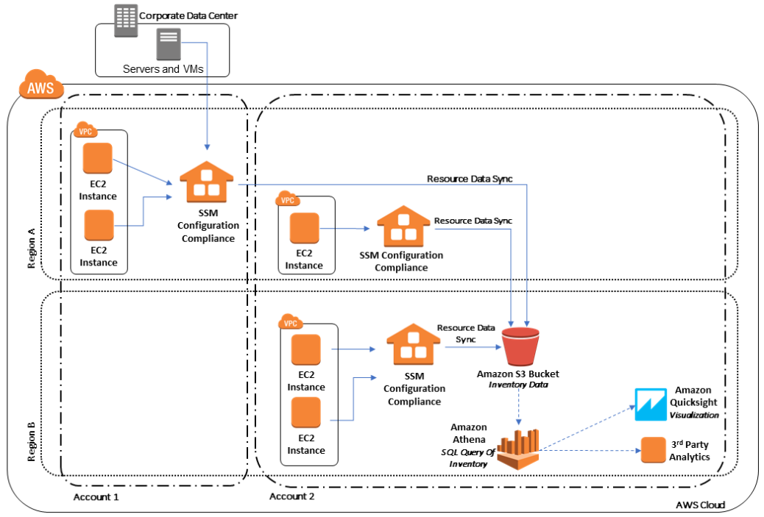
AWS Systems Manager - Instances & Nodes
Configuration Compliance
Scan your fleet of managed instances for patch compliance and configuration inconsistencies.
Features
View compliance history and change tracking for Patch Manager patching data and State Manager associations by using AWS Config.
Customize Systems Manager Compliance to create your own compliance types based on your IT or business requirements.
Remediate issues by using Systems Manager Run Command, State Manager, or CloudWatch Events.
Port data to Amazon Athena and Amazon QuickSight to generate fleet-wide reports.
SSM integrates with Chef InSpec. InSpec is an open-source, runtime framework that enables you to create human-readable profiles on GitHub or S3. Then you can use SSM to run compliance scans and view compliant and noncompliant instances.
For viewing current compliance status, use Config Compliance
For patching & compliance history & change tracking, use AWS Config
Task: Create a Resource Data Sync for Configuration Compliance
To send compliance data from all of your managed instances to a target Amazon S3 bucket.
With all compliance data stored in a target Amazon S3 bucket, you can use services like Athena and QuickSight to query and analyze the aggregated data.

Slide 12
AWS Systems Manager - Instances & Nodes
Inventory
Collect metadata from your managed instances from multiple AWS Regions and accounts.If the pre-configured metadata types collected by Systems Manager Inventory don't meet your needs, then you can create custom inventory.
Working with File and Windows Registry Inventory examples:
On Linux, collect metadata of .sh files in the /home/ec2-user directory, excluding all subdirectories. [{"Path":"/home/ec2-user","Pattern":["*.sh", "*.sh"],"Recursive":false}]
On Windows, collect metadata of all ".exe" files in the Program Files folder, including subdirectories recursively. [{"Path":"C:\Program Files","Pattern":["*.exe"],"Recursive":true}]
On Windows, collect metadata of specific log patterns. [{"Path":"C:\ProgramData\Amazon","Pattern":["*amazon*.log"],"Recursive":true}]
Limit the directory count when performing recursive collection. [{"Path":"C:\Users","Pattern":["*.ps1"],"Recursive":true, "DirScanLimit": 1000}]
Metadata types:
Applications
AWS components
Files
N/w configuration
Windows updates
Instance details
Services
Tags
Windows registry
Windows roles
Custom inventory
Use Systems Manager Resource Data Sync to send Inventory data collected from all of your managed instances to a single S3 bucket. Resource Data Sync then automatically updates the centralized data when new Inventory data is collected. With all Inventory data stored in a target S3 bucket, you can use services like Athena and QuickSight to query and analyze the aggregated data.
Inventory integrates with Athena to help you query inventory data from multiple AWS Regions and accounts. Athena integration uses Resource Data Sync so that you can view inventory data from all of your managed instances on the Inventory Detail View page in the SSM console. This feature uses AWS Glue to crawl the data in your S3 bucket, and Athena to query the data.

Slide 13
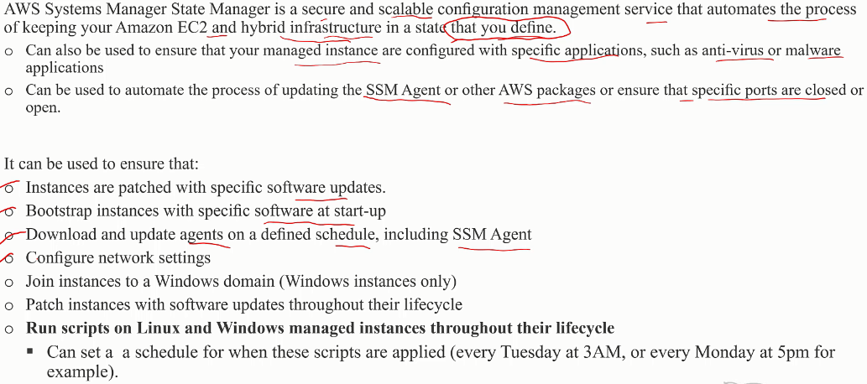
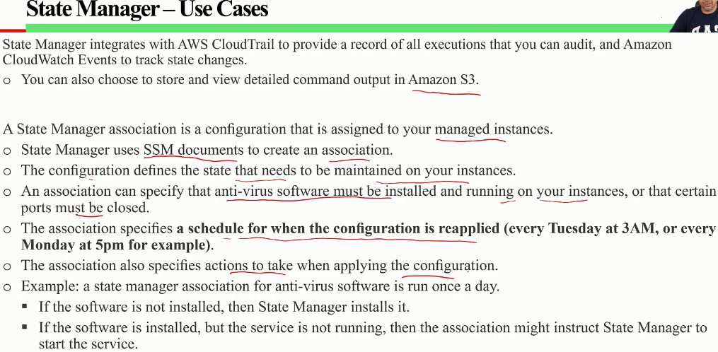
AWS Systems Manager - State Manager

Slide 14
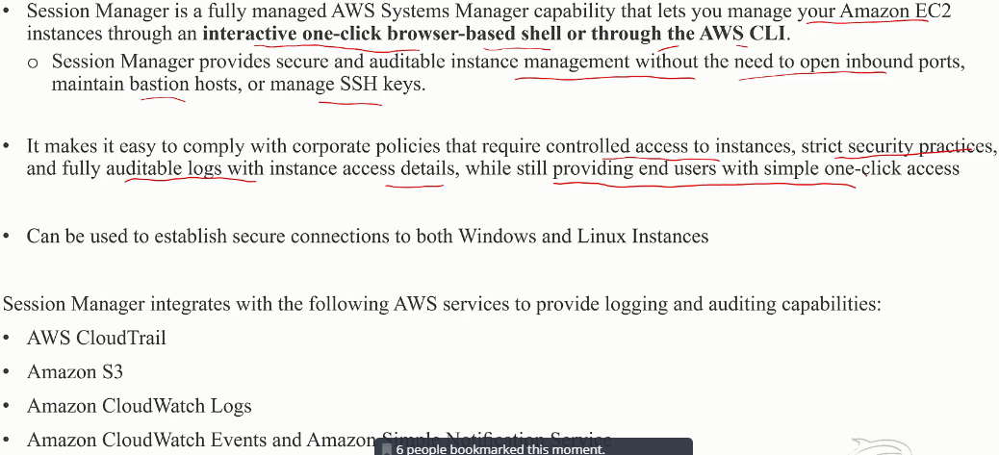
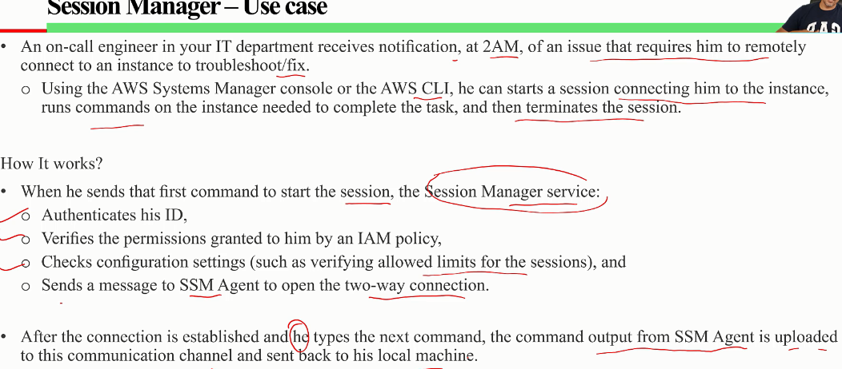
AWS Systems Manager - Session Manager

Slide 15
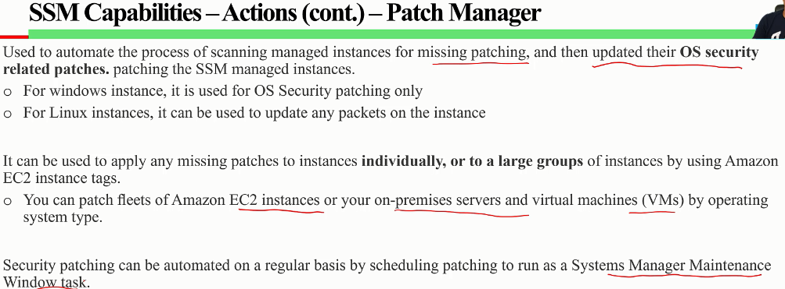
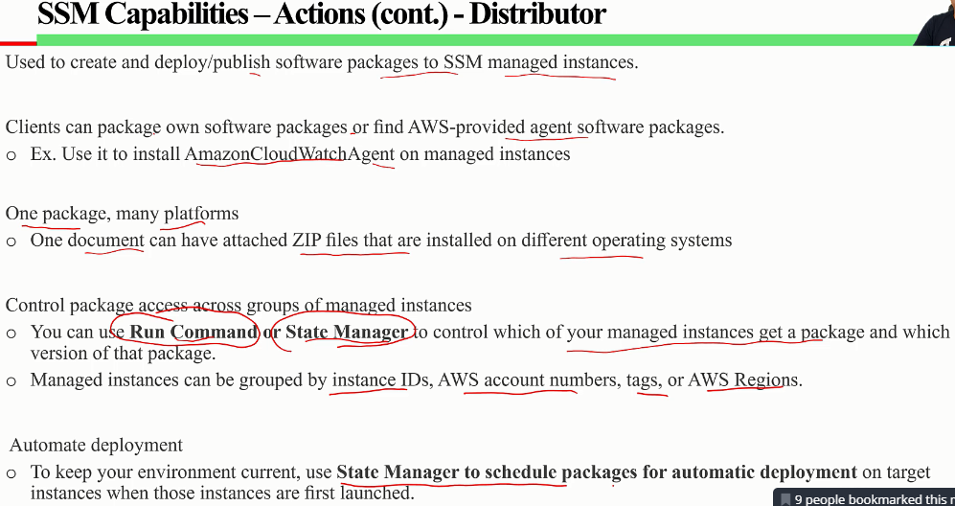
AWS Systems Manager - Patch Manager & Distributor

Slide 16
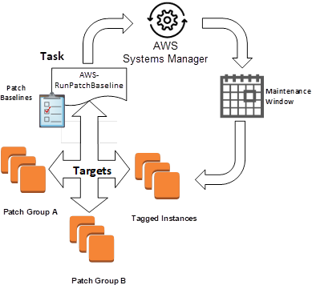
AWS Systems Manager - Example showing patching of windows instances
Step 1 → Use patch baselines to include rules for auto-approving patches within days of their release, as well to see a list of approved and rejected patches.
Step 2 → Leverage patch groups to organize instances for patching. E.g. create patch groups for dev/test/production.
Step 3 → Install patches on a regular basis by scheduling patching to run as a Maintenance Windows task
A Patch baseline defines which patches should and shouldn’t be installed on your instances.
Patch Manager has a pre-defined patch baseline that approves all patches classified as critical updates or security updates with a severity of Critical or Important. These patches are automatically approved by this baseline seven days after they are released by Microsoft.
A Patch group is an optional means of defining which patch baseline should be used for what instances. E.g dev/test/production. You can also create primary and secondary failover cluster groupings .
Patch groups can be created based on server function, e.g. web servers and db. Patch groups can help you avoid deploying patches to the wrong set of instances.
SSM Maintenance Windows let you define a schedule for when to perform potentially disruptive actions on your instances such as patching an OS, updating drivers, or installing software. Each Maintenance Window has a schedule, a duration, a set of registered targets, and a set of registered tasks. Typically you want to apply your patches at a time when there is the least impact to your organization.

Slide 17
Parameter Store vs Secrets manager
 | Parameter Store | Secrets Manager
Data can be stored as | Plain text & encrypted (w/ KMS) | Only encrypted (w/ KMS)
Integrate with IAM & CFormation | Yes | Yes
Stores value upto 4096 characters | Yes | Yes
Cost model | Free | Paid USD 40 cents / param & USD .05 cents / 10k Api calls
Secrets rotation | No | Automatic with RDS w/ lambda for other services
Generate random secrets | No | Yes
Cross account access | No | Yes

Slide 18
AWS Systems Manager - Use cases & Best practices
Automation
Create self-service runbooks for infrastructure as Automation documents.
Use Automation to simplify creating AMIs from the AWS Marketplace or custom AMIs, using public SSM documents or by authoring your own workflows.
Build and maintain AMIs using the AWS-UpdateLinuxAmi and AWS-UpdateWindowsAmi Automation documents, or using custom Automation documents that you create.
Inventory
Use Systems Manager Inventory with AWS Config to audit your application configurations over time.
Maintenance Windows
Define a schedule to perform potentially disruptive actions on your instances such as OS patching, driver updates, or software installations.
Parameter Store
Use Parameter Store to centrally manage global configuration settings.
Use Parameter Store to encrypt and manage secrets by using AWS KMS.
Use Parameter Store with ECS task definitions to store secrets.
Patch Manager
Use patch manager to rollout patches at scale and increase fleet compliance visibility across your instances.
Run Command
Manage Instances at Scale without SSH Access Using EC2 Run Command.
Audit all API calls made by on or on behalf of Run Command using AWS CloudTrail.
Use the targets and rate control features in Run Command to perform a staged command execution.
Use fine-grained access permissions for Run Command (and all Systems Manager capabilities) by using IAM policies.
State Manager
Update SSM Agent at least once a month using the pre-configured AWS-UpdateSSMAgent document.
Bootstrap EC2 Instances on launch using EC2Config for Windows
(Windows) Upload the PowerShell or DSC module to Amazon S3, and use AWS-InstallPowerShellModule.
Use Amazon EC2 tags to create application groups for your instances. And then target instances using the Targets parameter instead of specifying individual instance IDs.
Automatically remediate findings generated by Amazon Inspector by using Systems Manager.
Use a centralized configuration repository for all of your SSM documents, and share documents across your organization.
Managed Instances
Systems Manager requires accurate time references in order to perform its operations. If your instance's date and time are not set correctly, they may not match the signature date of your API requests. In some cases, this will lead to errors or incomplete functionality. For example, instances with incorrect time settings will not be included in your lists of managed instances.

